Slide 1



Guidelines for Grant Applicants
IPA Cross Border Cooperation Programme
Albania – Kosovo* 2014-2020
* This designation is without prejudice to positions on status, and is in line with UNSCR 1244 and the ICJ Opinion on the Kosovo Declaration of Independence
This programme is funded by EU

Slide 2

Global Objective of the CBC Programme :
To foster socio economic development and strengthen neighbourly relations through encouraging cooperation among people, communities and institutions
This programme is funded by EU

Slide 3
Priorities retained for this call for proposal :
Priority 1: Encouraging tourism, culture and natural heritage
Priority 2: Investing in youth, education and skills
This programme is funded by EU

Slide 4
-
Mainstreaming of cross-cutting issues:
Protection and promotion of ethnic minority rights including their participation in decision making processes
Democratic standards, anti-discriminatory practices and good governance
Gender equality and promotion of equal opportunities
Integration of persons with physical and mental disabilities
Protection of environment and preservation of natural resources and biodiversity
This programme is funded by EU

Slide 5


TOTAL EUR 2,040,000 (EU contribution)
Duration of the project: 18-30 months
Maximum EU Contribution (€): EUR 500,000
Minimum EU Contribution (€): EUR 250,000
15 % co financing
85 % EU contribution
This programme is funded by EU

Slide 6

Find the overall correct budget of the action: a)250000 b)287500 c)326200
Exercise
Minimum EU Contribution (€): EUR 250,000
Maximum EU Contribution (€): EUR 500,000
Find the overall correct budget of the action: a)500000 b)515000 c)575000
This programme is funded by EU

Slide 7
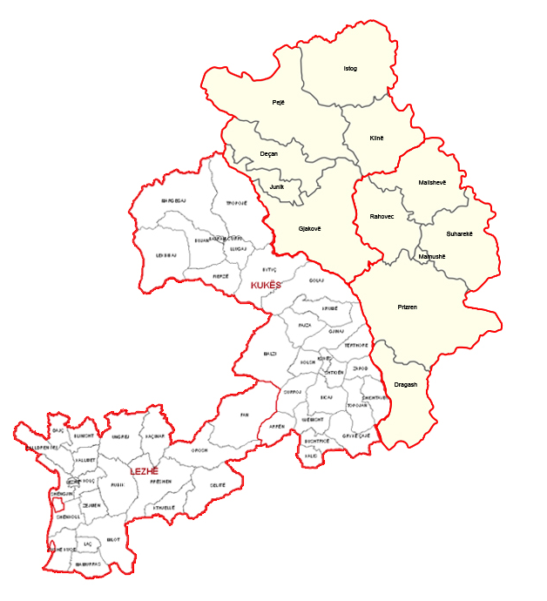
Eligible Area
Country | Regions | Municipalities
Albania | Kukes | Kukes, Has, Tropoje
 | Lezha | Lezha, Mirdita, Kurbin
Kosovo | South Economic Region | Prizren, Dragash, Rahovec, Suhareke, Malisheva, Mamusha
 | West Economic Region | Peja, Decan, Gjakove, Istog, Kline, Junik
This programme is funded by EU

Slide 8

2.1.1. Eligibility Criteria
Who may apply?
2. be directly responsible for the preparation and management of the action with the co-applicant(s) affiliated entity(ies), not acting as an intermediary;
1. be a legal person
3. Be effectively established in either Albania or Kosovo, or have a local branch office properly registered /established in Kosovo or Albania
4. be non-profit making for the purpose of this call
This programme is funded by EU

Slide 9

Eligibility Criteria
Applicants must be a be a specific type of institution or organization such as:
Central, regional and local government units (ministries, municipalities, departments, agencies
Local tourist organisations
Civil society organisations
National Parks, bodies and organisation for nature protection
Chambers of Commerce and Chambers of Crafts and Trades
Professional associations, and associations of SME's
public bodies acting as service providers
Education and training institutions (e.g. primary schools, VET schools, Universities, etc.)
Cultural institutions such as museums, libraries, orchestras, etc.
Research, development and innovation (RDI) institutions
Agencies for local or regional development
local authorities, local governments and their institutions, associations of municipalities,
This programme is funded by EU

Slide 10

Eligibility Criteria
The lead applicant and co-applicant(s) must represent different legal entities and must not be country branches of the same organisation or institution.
If the lead applicant is established in Albania at least one co-applicant must be established in Kosovo* and vice-versa
Co-applicants must satisfy the eligibility criteria as applicable to the lead applicant
This programme is funded by EU

Slide 11

2.1.2.Eligibility Criteria
Affiliated Entities- only entities having a structural link with the applicants (i.e. the lead applicant or a co-applicant), in particular a legal or capital link.
Membership, i.e. the applicant is legally defined as a e.g. network, federation, association in which the proposed affiliated entities also participate or the applicant participates in the same entity (e.g. network, federation, association) as the proposed affiliated entities.
Entities directly or indirectly controlling the applicant (parent companies)
Entities under the same direct or indirect control as the applicant (sister companies).
Entities directly or indirectly controlled by the applicant (daughter companies
or first-tier subsidiaries),(granddaughter companies or second-tier subsidiaries)
This programme is funded by EU

Slide 12


2.1.3 Eligibility Criteria
Associates
Other organisations involved in the action but who may not receive funding from the grant with the exception of per diem or travel costs. Associates do not have to meet the eligibility criteria of the applicant and co-Applicant(s).
Contractors
Contractors are neither co-applicants nor associates, and are subject to the procurement rules set out in Annex IV to the standard grant contract.
This programme is funded by EU

Slide 13


Ineligible Actions- pg.16-17
actions concerned only or mainly with individual sponsorships for participation in workshops, seminars, conferences and congresses;
actions concerned only or mainly with individual scholarships for studies or training courses or research;
actions aimed at the upgrading of infrastructure and equipment in privately owned facilities;
preparatory studies or preparation of preliminary design for works to be carried out within the project;
actions without a tangible cross-border impact;
This programme is funded by EU

Slide 14
Ineligible Actions- pg.16-17
actions linked to political parties;
actions including commercial and profit-making activities ;
actions which fall within the general activities of competent state institutions or state administration services, including local government;
actions confined to charitable donations;
actions covered and financed by other EU funded programmes;
This programme is funded by EU

Slide 15

Financial support to third parties (sub-granting)
Applicants must not propose financial support
to third parties.
Sub-granting is not allowed under this call
This programme is funded by EU

Slide 16

investment in airport infrastructure unless related to environmental protection or accompanied by investment necessary to mitigate or reduce its negative environmental impact;
Ineligible pg.21
undertakings in difficulties as defined under Union State aid rules;
value added tax (VAT) except when it is non-recoverable under national VAT legislation;
the decommissioning and the construction of nuclear power stations;
debts and debt service charges (interest on debt);
investment to achieve the reduction of greenhouse gas emissions from activities falling under Annex I to Directive 2003/87/EC of the European Parliament and Council of 13 October 2003;
the manufacturing, processing and marketing of tobacco and tobacco products;
This programme is funded by EU

Slide 17


Other Ineligible Costs
provisions for losses or potential future liabilities;
cost declared by the beneficiaries and financed by another operation or work programme receiving a Union grant;
currency exchange losses; credits to third parties;
fines, financial penalties and expenses of litigation;
the purchase of land not built on and land built on in the amount of more than 10% of the total eligible expenditure of the operation if it is justified by the nature of the operation.
In addition, the following costs are not eligible either:
- consultant fees between the beneficiaries for services or work carried out within the project;
- remuneration of any kind for staff of any of the beneficiaries being hired as external experts or freelance consultants;
- taxes, customs and import duties and levies and/or charges having equivalent effect.
This programme is funded by EU

Slide 18

Number of proposals and grants
An entity may not submit more than
one application as Lead applicant under
this call for proposals.
A Lead applicant may at the same time
be a co-applicant or affiliated entity
in maximum one other application.
A co-applicant may not take part in more than two applications.
Non-compliance with the above will result of exclusion of all applications concerned.
In all cases, the capacity of the entity (applicant or co-applicant) to implement more than one grant will be assessed.
This programme is funded by EU

Slide 19


Eligibility of costs
All costs must be expressed in EURO (€)
Eligible direct costs – must comply with Art. 14 of GC
Contingency reserve (max 5%, and subject to CA’s prior approval)
Eligible indirect costs (administrative costs max 7%)
The applicant should provide a realistic and cost-effective budget
Note: Simplified Cost Option may be used for 1.3 Per diems, 2.2. Local transportation and 4.0 Local Office – Refer to Annex K for instructions
This programme is funded by EU

Slide 20

VISIBILITY
Applicants are requested to include in their Full Applications and Budget (minimum recommended 2%) their planned measures to guarantee the visibility of the activities implemented
This programme is funded by EU

Slide 21


Restricted Call for Proposals
(on-line submission via
PROSPECT):
Step 2: Only pre-selected applicants submit Full Application
Step 1: Submission of Concept Notes only
This programme is funded by EU

Slide 22


To apply to this call for proposals organisations must register in PADOR and submit their application in PROSPECT
This programme is funded by EU

Slide 23

This programme is funded by EU

