Slide 1



How to prepare your Concept Note.
IPA Cross Border Cooperation Programme
Albania – Kosovo* 2014-2020
* This designation is without prejudice to positions on status, and is in line with UNSCR 1244 and the ICJ Opinion on the Kosovo Declaration of Independence
This programme is funded by EU

Slide 2
The Concept note should give a snapshot of the full grant application
It must only mention an estimate of the EU contribution and the indicative percentage of EU contribution
Respect layout parameters:
  Font size Arial 11 with 2 cm margins and single space
  Max. 5-pages limit for the entire concept note
Maintain section headings and provide responses immediately underneath the guide questions in each heading.

Slide 3
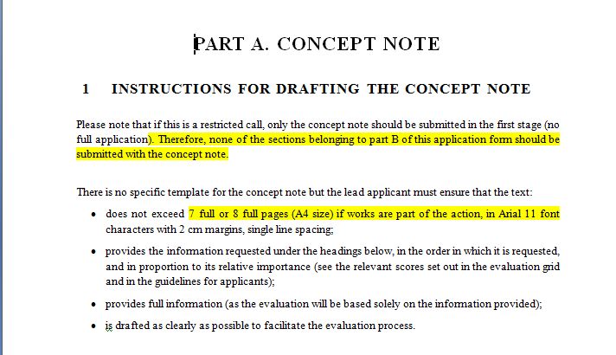

Slide 4
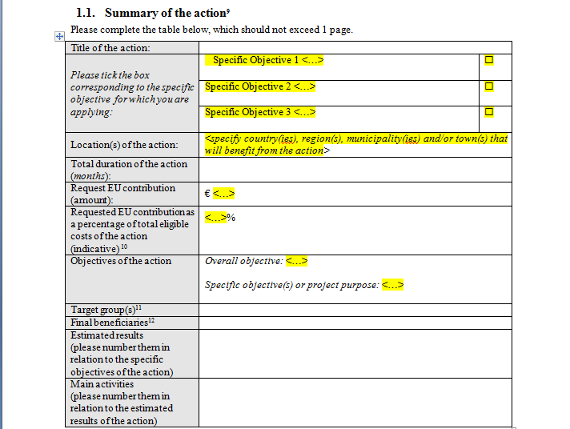

Slide 5
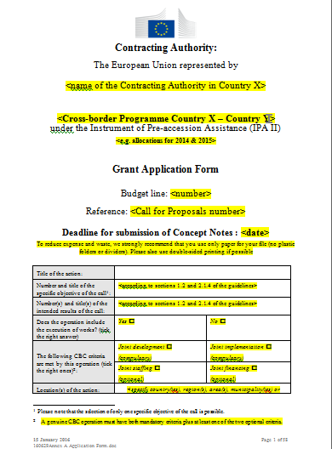
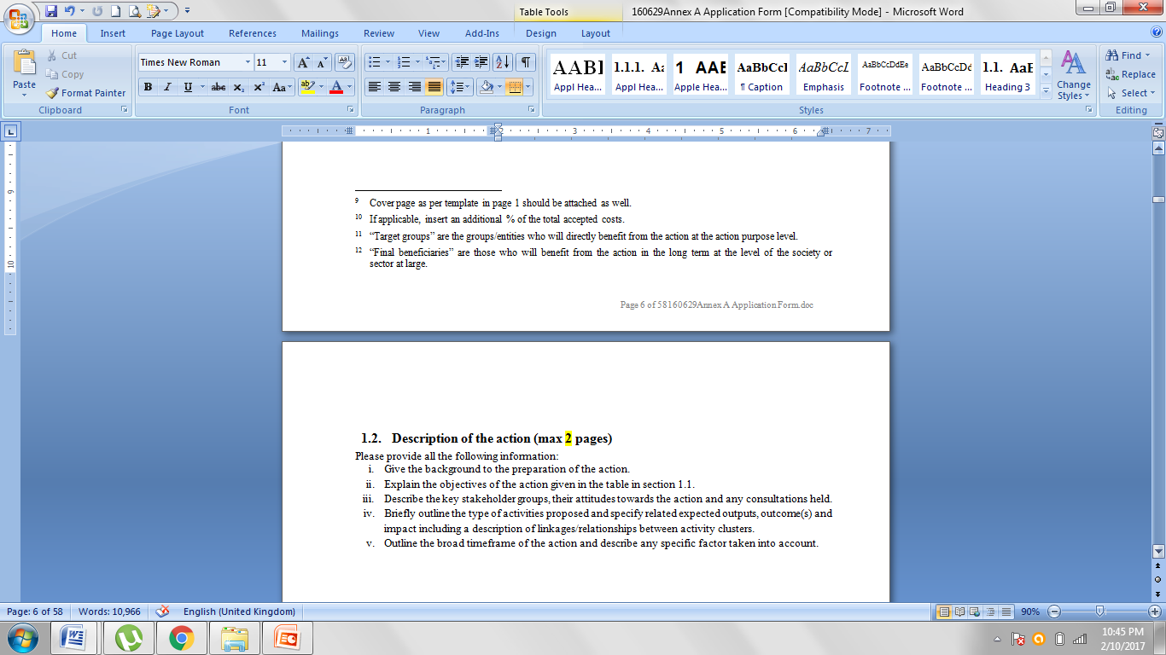

Slide 7
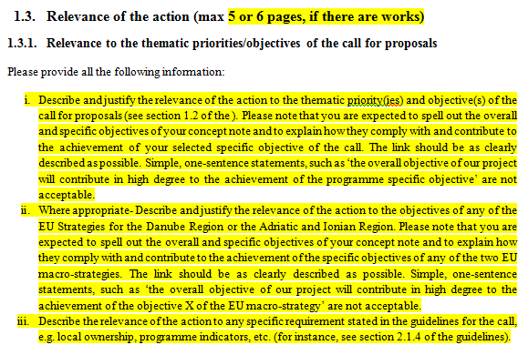

Slide 8
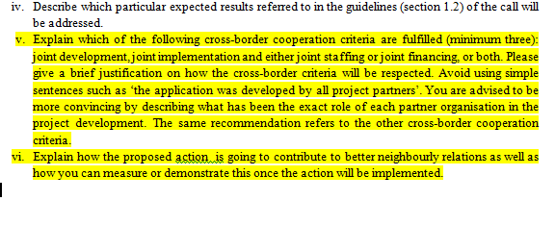

Slide 9
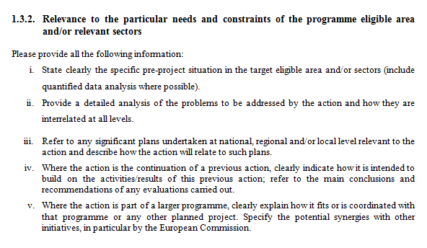

Slide 10
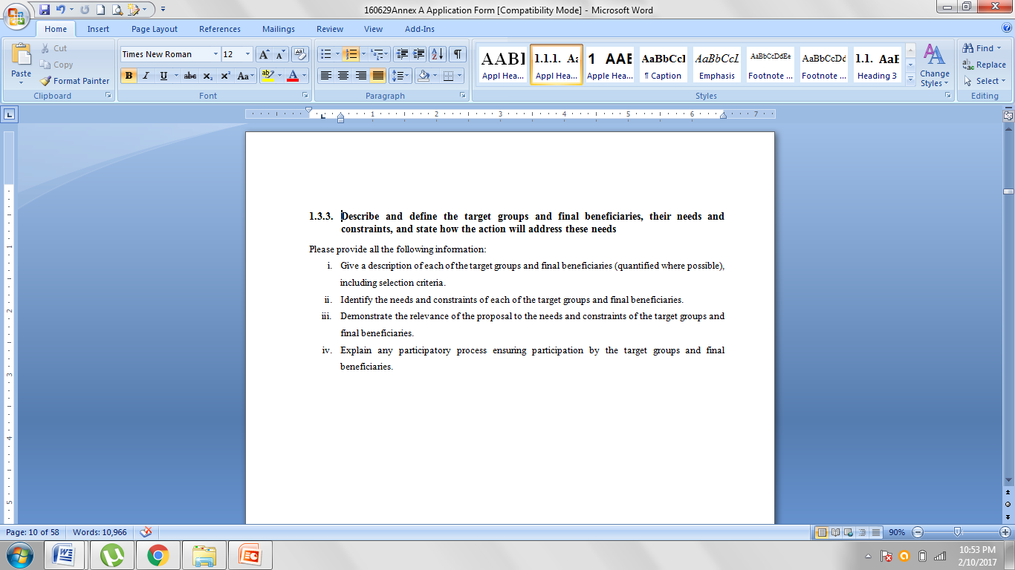

Slide 11
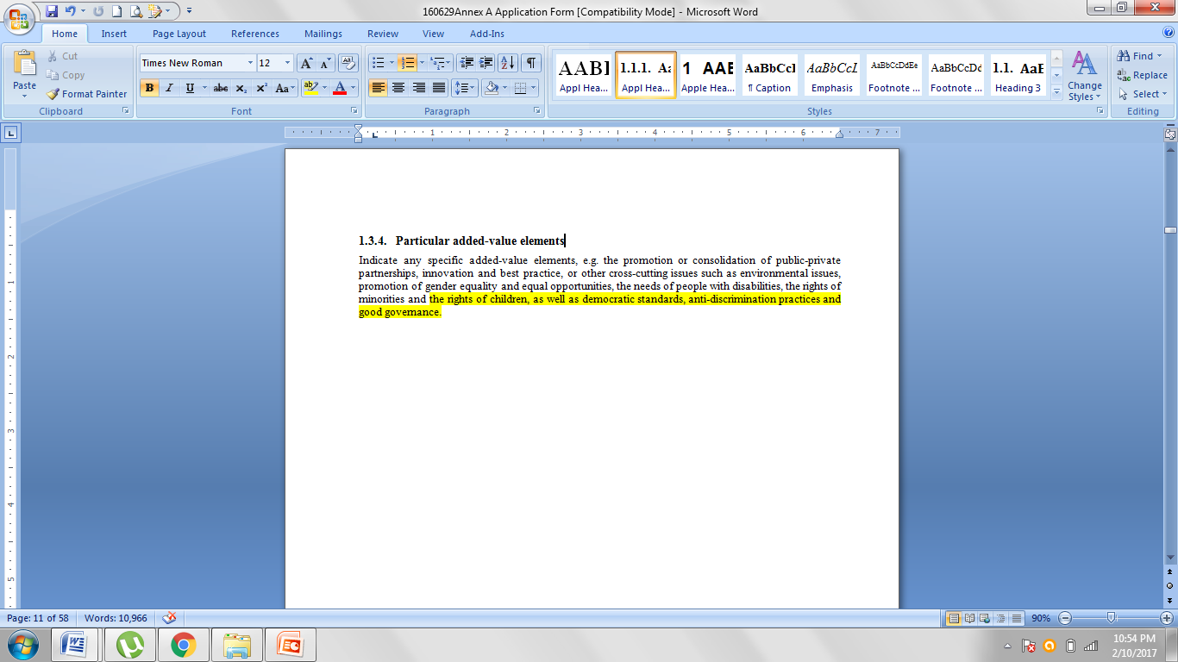

Slide 12
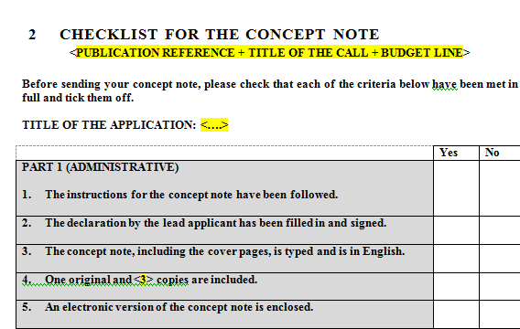

Slide 13
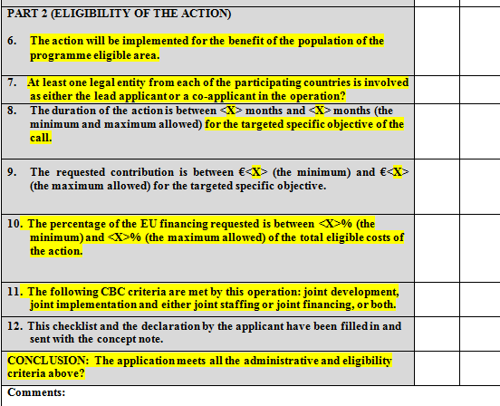

Slide 14
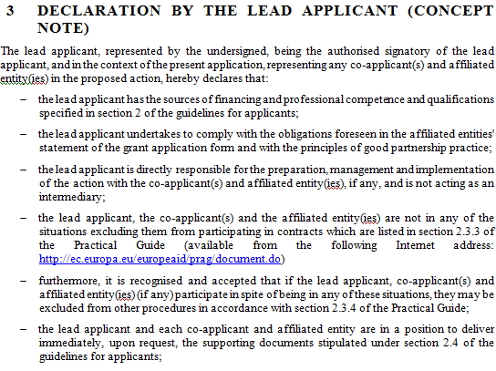

Slide 15
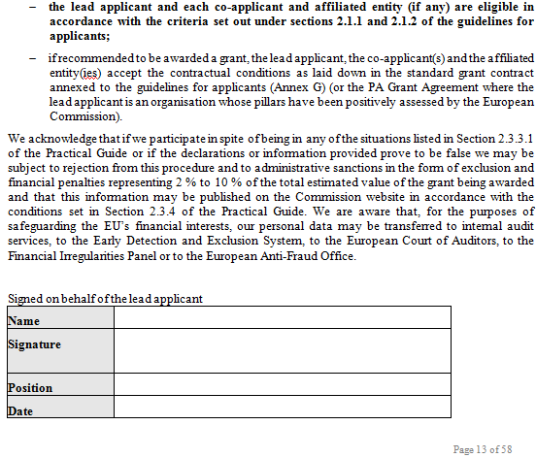

Slide 16
 | Scores
1. Relevance of the operation | Sub-score | 30
1.1 How well justified is the relevance of the concept note to the thematic priorities and specific objectives of the Call for Proposals? Will the project contribute to the achievement of programme indicators?* | 5x2**
1.2 How relevant is the concept note to the particular needs and constraintsof the eligible programme area and/or relevant sector (including, as appropriate, synergies with other EU initiatives, in particular with the EU Strategy for the Danube Region and the one for the Adriatic and Ionian Region, as well as avoidance of duplication)? | 5x2**
1.3 How clearly defined and strategically chosen are those involved (final beneficiaries, target groups)? Have their needs been clearly defined and does the proposal address them appropriately? | 5
1.4 Does the concept note contain specific added-value elements, such as environmental issues, promotion of gender equality and equal opportunities, needs of disabled people, rights of minorities and children, democratic standards and good governance, or innovation and best practices? | 5
2. Design of the operation | Sub-score | 20
2.1 How coherent is the overall design of the operation? In particular, does it reflect the analysis of the problems involved, take into account external factors and have included the interest of relevant stakeholders? | 5x2**
2.2 Are the activities proposed feasible and consistent in relation to the objectives and expected results in the given timeframe of the operation? In the event of works, are the explanations provided convincing to assess their maturity and feasibility? | 5x2**
TOTAL SCORE |  | 50

Slide 17
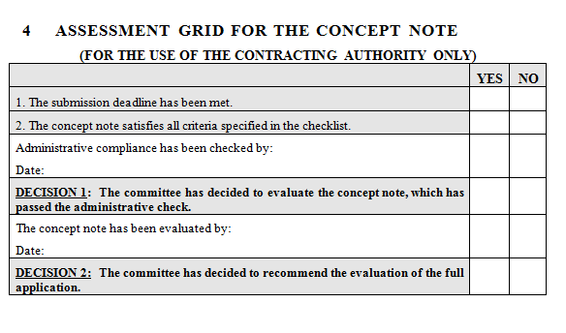

Slide 18
Deadline : 16 March 2017 at 12:00h. Tirana time
On-line via PROSPECT (https://webgate.ec.europa.eu/europeaid/prospect
Using Annex A.1 – Concept Note
In English
Costs expressed in EURO
Please do not forget the Checklist
Incomplete Concept Notes may be rejected

Slide 19
OPENING SESSION & ADMINISTRATIVE CHECK
The deadline has been respected
Concept Note satisfies criteria mentioned in the Checklist:
  Followed the instructions
  In English
  Action in the country
  Duration of the action: 18-30 months
  Request for contribution within limits stated in the respective thematic priority (250,000 € - 500,000 €)
  PADOR Registration number for the Lead applicant, and the co-applicants
  Declaration by the applicant and Checklist: filled in and signed
  Will include the eligibility check of the action

Slide 20
  RESULT OF THE CONCEPT NOTE EVALUATION
  1)Minimum 30 points for pre-selection, list created ranking the CNs based on scores (list per priority)
  2) Highest ranking CNs whose aggregate amount reaches at least 200% of the available budget per priority, will be pre-selected and will be invited to submit Full Application (invitation will appear in the PROSPECT profile of the lead applicant)
  3) Pre-selected Applicants will be given a min of 45 days to submit the Full Application

Slide 21


Slide 22


